Slide 1
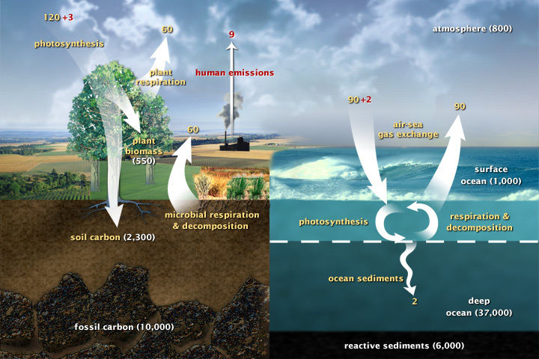
Recap: Carbon fluxes in Earth’s climate system (2003)

Slide 2
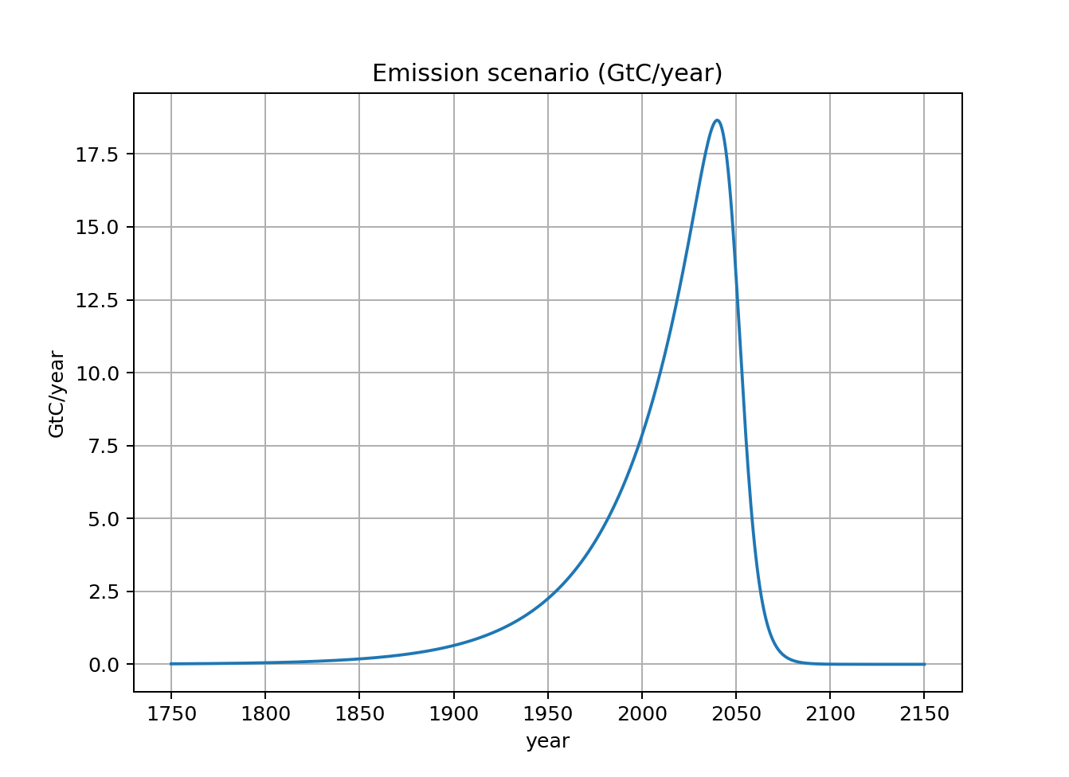
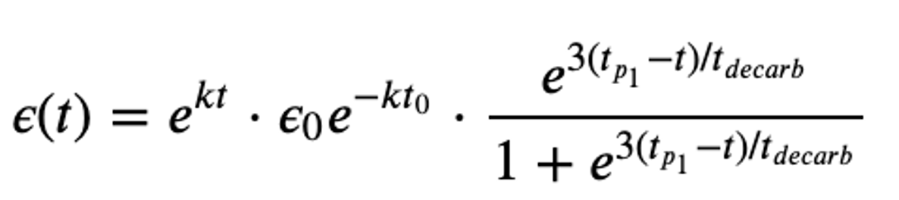
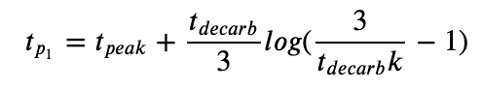
In ScheduledFlows, we create “emissions scenarios” (like those that informed RCPs, etc.)

Slide 3
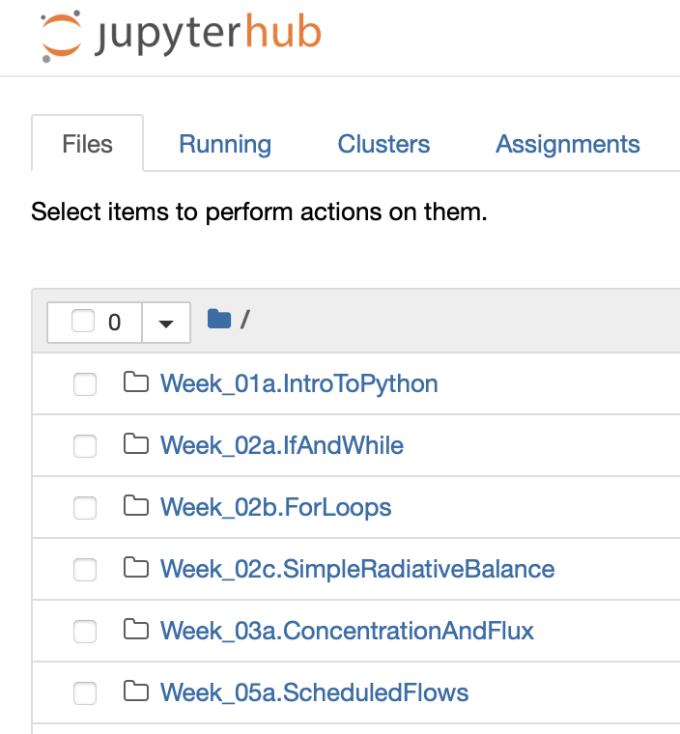
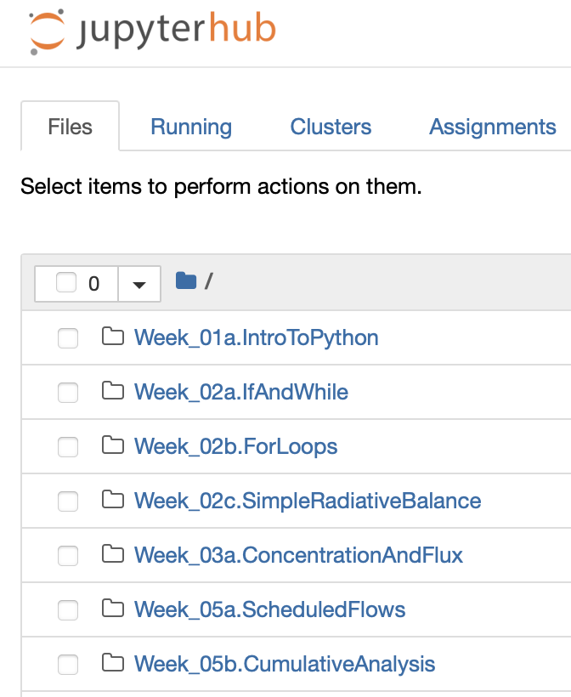
Once your schedule is created …
Saving it as a file on the Python server:
Downloading it to your laptop:
Uploading it from your laptop:
Notes:
Predict the temperature if CO2 continues to rise. If we reduce CO2 emissions to zero.

